Slide 1
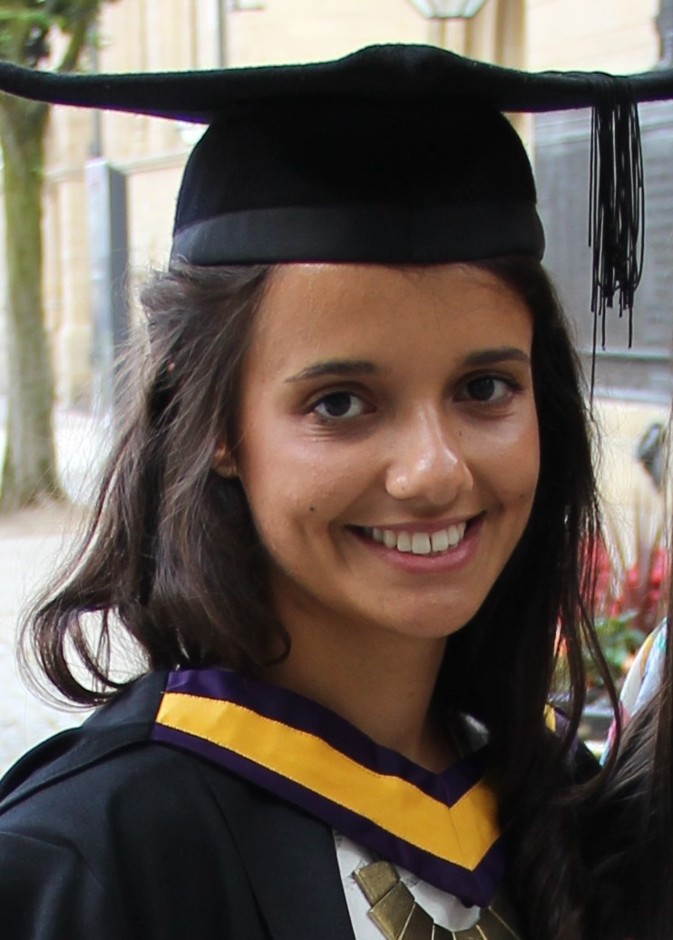
Profile of a Healthcare Scientist
Full name: Rhea McArdle
Job title/role: Trainee Healthcare Scientist on the Scientist Training Programme (STP)
Healthcare Science Specialism: Histocompatibility & Immunogenetics (H&I)
What does your job involve? (brief overview)
I perform technical (hands-on lab work!) and analytical (using specialist software) work to support H&I testing in our lab – we perform molecular genetics and serological testing for patients/recipients and their potential donors leading up to solid organ or haematopoietic stem cell (HSC) transplantation. We perform searches for HSC donors using international registries, and we provide advice to clinical transplant teams on the risk associated with transplantation from our specialist H&I perspective. I am studying part-time for an MSc in Clinical Science with the University of Manchester (UoM), and I am also completing an e-portfolio within my workplace.
What’s the best thing about your job?
Knowing that the work we do is incredibly meaningful as we help facilitate organ donation which is a life-saving treatment option for patients with, for example, organ failure or haematological malignancies (e.g., leukaemia).
What qualifications led you to this role?
To get onto the STP I needed a 2:1 in a Life Sciences undergraduate honours degree. I studied Biomedical Sciences at UoM – that’s me on the right at graduation!
What career opportunities are available?
I hope to become a Clinical Scientist in the NHS, perhaps one day train to be a Consultant Scientist
Do you have advice for someone interested in a career in healthcare science? There are so many different specialisms – try and get some experience to know which area is right for you! Be prepared to work hard -but knowing you are making a difference makes it all worthwhile

